Slide 1

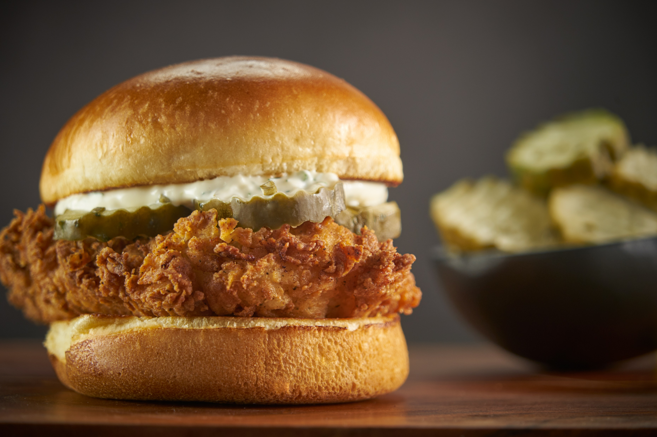


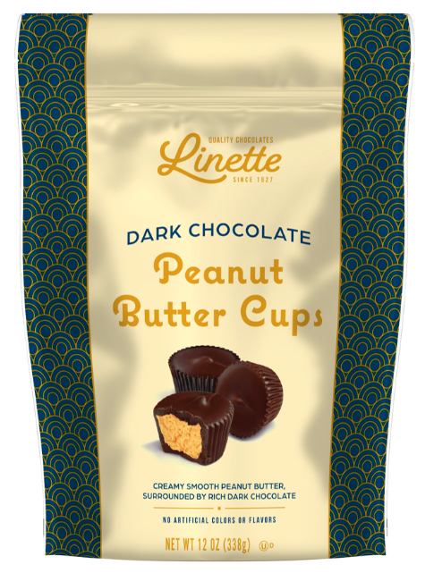





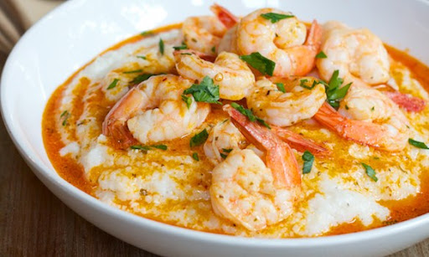

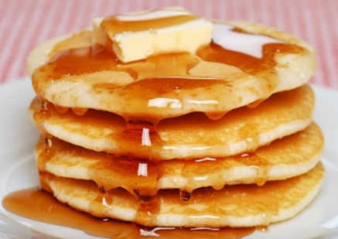
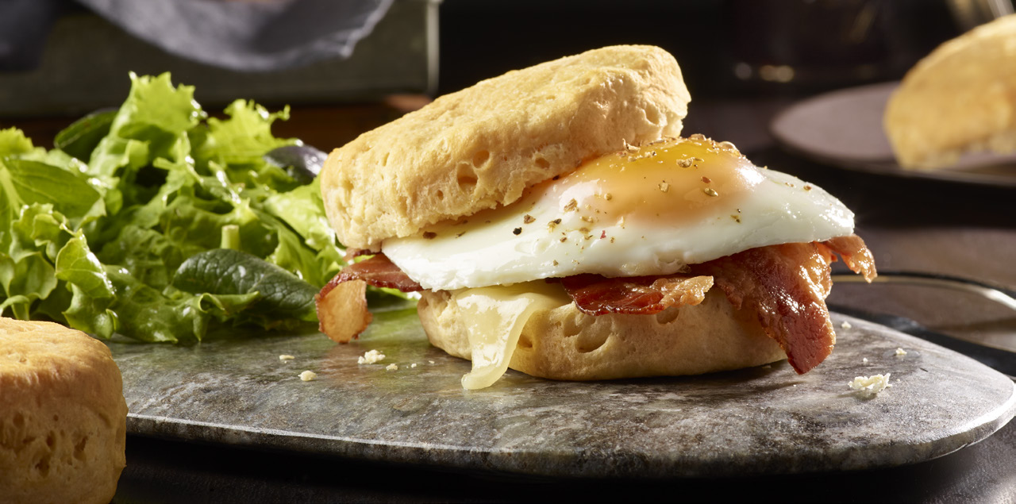

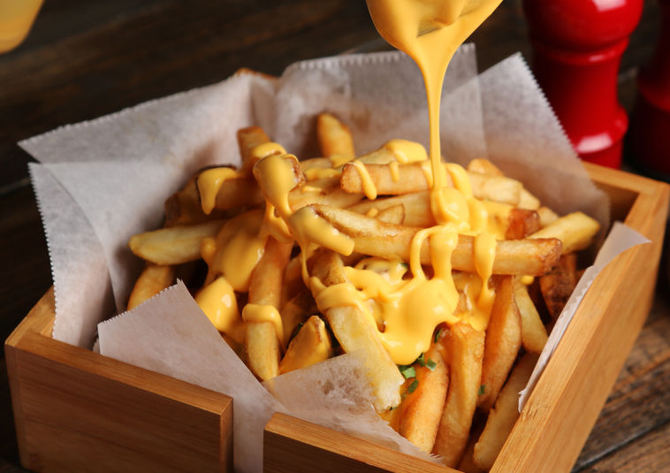
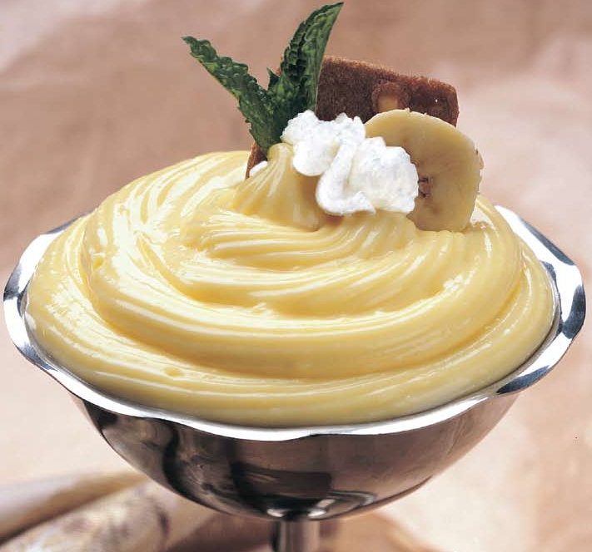



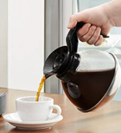
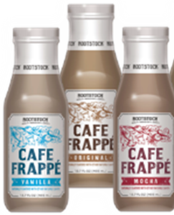





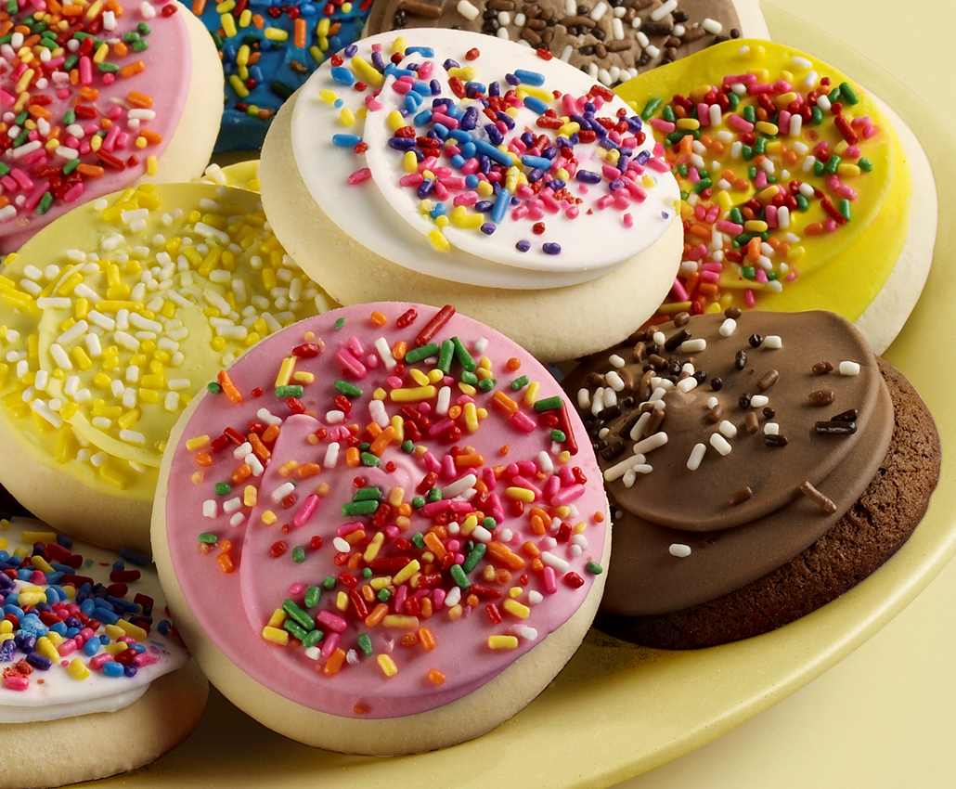
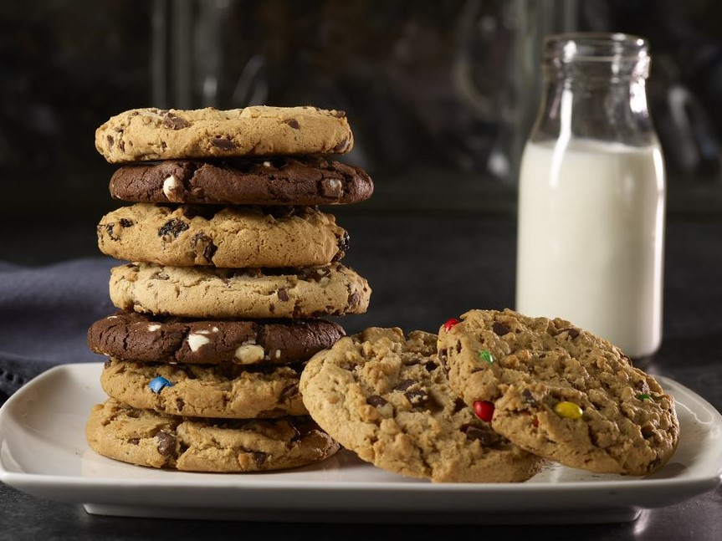

PICKLES & PEPPERS
Premium, Refrigerated & Shelf-Stable
Relish
Sauerkraut
BAKED SNACKING & CANDY
Cookies
Pretzels
Cookie/Candy pieces
Crackers
Candy
HOT CEREAL
Traditional &
Steel-Cut Oatmeal
MEALS
Grits & Farina
BAKERY GOODS
    Waffles & Pancakes RTE
    Refrigerated Dough
PLATE ENHANCERS
Cheese Sauces & Pudding
Aseptic broth
BEVERAGES
*New* Ground & Whole Bean Bagged Coffee
Ready-to-Drink Coffee & Cold Brew
Single-Serve Coffees, Teas, Cappuccino & Cider
DESSERTS
  Cookies (Frosted Sugar, Wire Cuts & Shaped)
  Shortbread

